Slide 1
Constructor Design Pattern
The “constructor pattern”, as the name defines, is a class-based pattern that uses the constructors present in the class to create specific types of objects.
When to use the constructor pattern?
You can use it when you want to create multiple instances of the same template since the instances can share methods but still be different.
Example:
libraries
plugins @ShankaragoudaG

Slide 2
Constructor function
As we saw earlier, JavaScript doesn’t support the concept of classes, but it does support special constructor functions that work with objects.
By simply prefixing a call to a constructor function with the keyword new, we can tell JavaScript we would like the function to behave like a constructor and instantiate a new object with the members defined by that function.

Slide 3
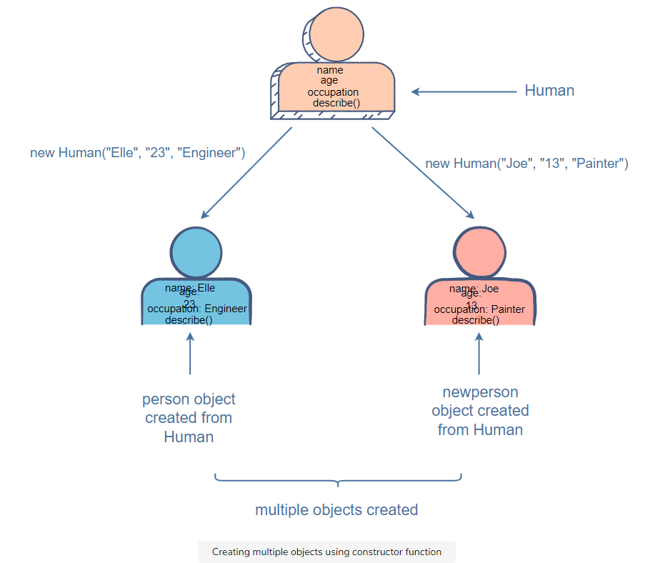
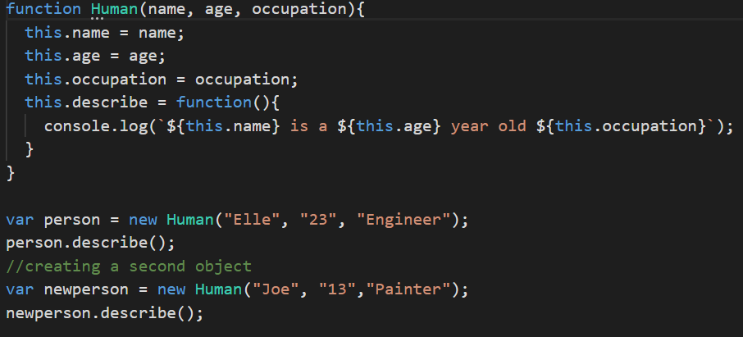
Constructor function Example

Slide 4
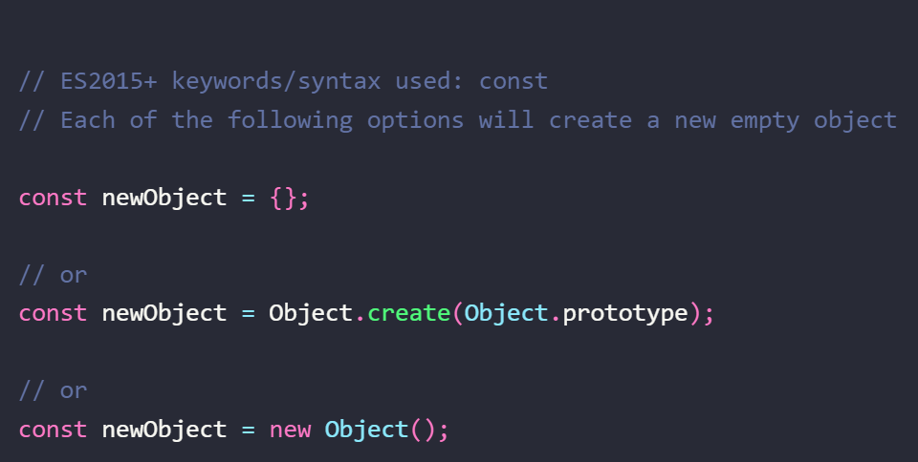
Object Creation

Slide 5
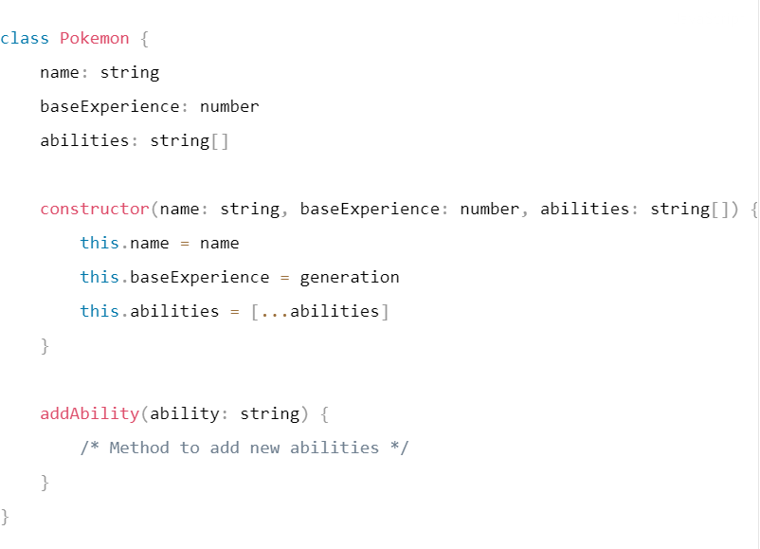
ES2015 Class based constructor
The constructor method is a special method that gets called when we instantiate the class using the new operator. The constructor method does the work of assigning values to the instance variables of the class to create a new object.

Slide 6
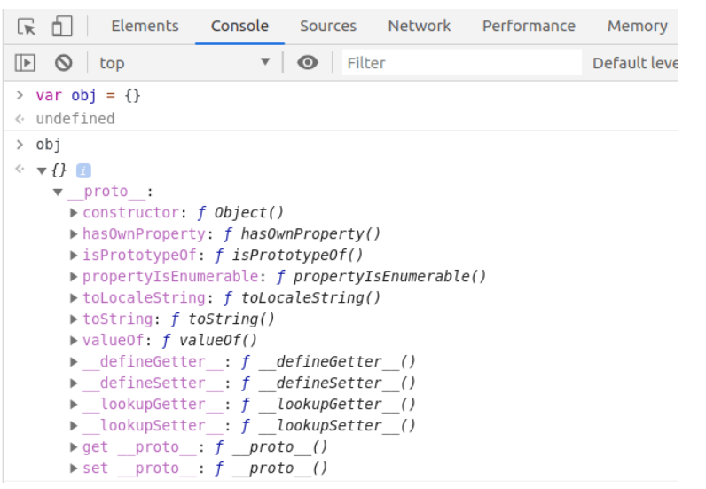
Object Properties and Methods
You can check list of properties and methods available for object in chrome console.

